Slide 1


Energy Storage Capacity Analysis
Electric Power Load Analysis (EPLA)
Revision of 20 June 2026
Dr. Norbert Doerry
http://doerry.org/norbert/MarineElectricalPowerSystems/index.htm
© 2026 by Norbert Doerry
This work is licensed via: CC BY 4.0 (https://creativecommons.org/)

Slide 2
Essential Questions
What is quasi-steady state simulation? | Understand
What are the three major technologies used for shipboard energy storage systems? | Understand
What are the different functions of energy storage? | Understand
How is energy storage capacity determined for the different energy storage system applications? | Understand

Slide 3
Energy Storage Functions
ESM-F1: Provide power of requisite power quality to loads during short term power disruptions of up to the reconfiguration time (t1).
ESM-F2: Provide power of requisite power quality to loads during power disruptions of up to the generator start time (t2).
ESM-F3: Provide power for the emergency starting of generator sets.
ESM-F4: Provide load leveling for pulsed loads, generator sets with slow dynamics, and generator sets operating near their capacity.
ESM-F5: Provide primary power with or without other generator sets online.

Slide 4
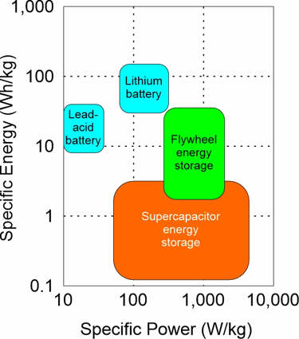
Energy Storage Technologies
Energy Storage
  Batteries
    Lead acid
    Lithium Ion
    Lithium Iron Phosphate
  Flywheels
  Supercapacitors
Power electronics
Transfer Switch
Controls

Slide 5
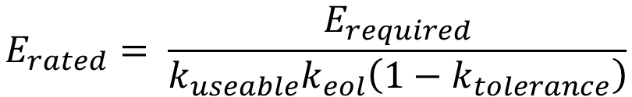
Energy storage capacity
Minimum and maximum SOC
  Useable energy storage is less than the rated energy storage
  Based on
    Energy storage type
    Preserving life of energy storage
    Capability of power conversion
End of life capacity (SOH)
  Only have about 80% capacity at end of life
  Energy storage should be capable of achieving its goals over its life
Components may have wide tolerance for ratings
  Supercapacitors for example typically have 20% tolerance
  Usually assume worst case.
Life of batteries and supercapacitors depend on:
  Temperature
  Average state-of-charge
  Number of charge-discharge cycles
$$E_{rated}= \frac{E_{required}}{k_{useable}k_{eol}\left(1−k_{tolerance}\right)}$$
E_{rated} = Energy storage capacity needed to ensure E_{required}
E_{required} = amount of required energy storage
k_{useable} = fraction of rated energy that is useable (0.5 to 1.0)
k_{eol} = End of life fraction of rated energy (0.7 to 1.0)
k_{tolerance} = tolerance of energy storage value ( 0.0 to 0.2)

Slide 6
Quasi-steady state analysis
In modeling components, assume:
  Fast dynamics occur instantaneously – use the final steady-state value
  Slow dynamics don’t change at all – use the initial condition
  Only model dynamics with time constants within a certain time range.
For energy storage analysis, components are modeled to calculate the power flow (and possibly the voltage and current) at electrical terminals as a function of time.
  Time steps on the order of a second often used.
For calculating the amount of energy needed by a bulk energy storage system:
  Usually ignore dynamics that happen faster than about 100 ms.
  Usually ignore dynamics that happen slower than a day.
Simulation used to determine E_{required}
  Margin and Service Life Allowance should be accounted for.
Need to convert E_{required} to E_{rated} based on properties of the energy storage system.

Slide 7
Determining Energy Storage Requirements:
Types of studies
UPS vs fast circuit breaker studies (ESM F-1)
  Trade-off use of UPS with slow circuit breakers against use of fast circuit breakers with minimal UPS.
Standby generator start simulations (ESM F-2)
  Trade-off centralized energy storage with decentralized energy storage to provide power to loads after a generator set trips offline and before the standby generator comes online.
Reserve power studies (ESM F-2)
  Study examines use of energy storage for cases where load exceeds online generation capacity and additional generation has not yet come online.
Dark ship start simulation (ESM F-2 and ESM F-3)
  Determines if the system is capable of restarting following loss of all online generator sets, but before energy storage is depleted.

Slide 8
Determining Energy Storage Requirements:
Types of studies (continued)
Load-leveling study (ESM-F4)
  Examines support of sources (such as fuel cells) that are not capable of fast enough dynamic response to achieve power quality requirements.
  Examines the benefit of enabling generator sets to operate near their power rating by providing power when the load temporarily exceeds generator set rated power.
  Examines compensating for pulsed loads by providing the deviation (either sourcing or sinking) around the average power for the pulsed load.
Zonal and compartment survivability analysis (ESM-F5)
  Examines sufficiency of energy storage to achieve zonal and compartment survivability
Endurance energy calculations (ESM-F5)
  Calculated required power and energy of energy storage to achieve a specified endurance requirement.
  Based on a variation of the methods in DPC 200-1 for calculation the endurance fuel requirements for a ship.

Slide 9
UPS vs fast circuit breaker studies (ESM F-1)
Study starts with identifying the maximum power disruption that critical loads can endure.
Examines economic trade-off with using fast circuit breakers (as compared to traditional circuit breakers) to classify more critical loads as short-term interrupt rather than uninterruptible.
  Fast circuit breakers must be applied throughout the system to reduce t1
  Uninterruptible loads supplied via an uninterruptible power supply
  Compare cost of fast circuit breakers everywhere vs cost of providing UPS for those loads that need it.
UPS must be able to provide in-rush current and should have sufficient energy rating to accommodate long term capacity degradation.
The cost of periodically replacing UPS energy storage should be accounted for.

Slide 10
Standby generator start simulations (ESM F-2)
Scenario: At least 2 gensets online; one drops offline and remaining gensets do not have sufficient capacity
Employ quasi-steady-state simulation to determine if system response is satisfactory
  Load shedding
  Starting of standby generators (sufficient energy for 6 starts)
  Paralleling and loading of standby generator
  Recharging energy storage
Energy storage should be evaluated to determine if it has sufficient energy and power capacity.
Differs from 24-hour average simulations in that system is in transition, not steady-state.
If models are stochastic, the period of time from genset dropping off line to energy storage recharged should be simulated many times.

Slide 11
Reserve power studies (ESM F-2)
Scenario: The total load increases significantly to a level beyond the rating of online generator sets. Energy storage provides power until one or more standby generators are brought online to service the new total load and charge the energy storage.
Employ quasi-steady-state simulation to determine if system response is satisfactory.
Energy storage should be evaluated to determine if it has sufficient energy and power capacity.
If models are stochastic, the period of time from load increasing beyond the rating of online generator sets to energy storage recharged should be simulated many times.

Slide 12
Dark ship start simulation
(ESM F-2 and ESM F-3)
Scenario: Dark ship start: All online generator sets trip offline, but energy storage is available
Employ quasi-steady-state simulation to determine if system response is satisfactory.
  Start of emergency generators
  Energizing of emergency buses
  Start of standby generators
  Powering all loads
  Securing emergency generator
  Recharging Energy Storage
Energy storage should be evaluated to determine if it has sufficient energy and power capacity.
If models are stochastic, the period of time from generator sets tripping offline to energy storage recharged should be simulated many times.

Slide 13
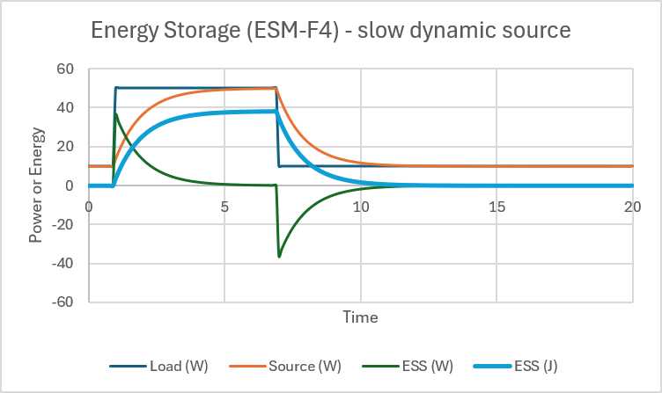
Load-leveling study (ESM-F4) – Slow dynamic sources
Scenario – have source with slow dynamic performance (such as fuel cell).
  Energy storage used to provide difference between power demand and power provided by source.
  Over long run, energy storage SOC regulated to midway between its minimum and maximum value. (min + half of useable energy)
Employ transient analysis to determine required power and energy capacity of the energy storage system
  Model the controls and system dynamics of both the source and energy storage.
  Energy storage should have sufficient energy capacity so that neither its maximum or minimum SOC is exceeded.
First approximation for energy storage system power and energy
  Power rating of energy storage should be at least the largest step load change (with margin applied).
  The useable energy rating of energy storage should be a multiplier times twice the product of the largest step load change (with margin applied) times the source time constant (seconds)
    Multiplier enables handling several step load changes at nearly the same time.
    Because more load changes are possible with a longer source time constant, the multiplier should be greater for a longer time constant.

Slide 14
Load-leveling study (ESM-F4) – Operating near power rating
Scenario: Enabling sources to operate near their power rating by providing power when the load temporarily exceeds the power rating of the sources
  Length of temporary time duration is a design variable, typically on order of several minutes.
Employ quasi-steady-state simulation to determine if system response is satisfactory.
  Load exceeds generator rating for short period of time
  Load returns to below generator rating; energy storage recharges
  Load exceeds generator rating for an extended period of time
  Standby generator set starts and comes on line
  Energy storage recharges
Energy storage should be evaluated to determine if it has sufficient energy and power capacity.

Slide 15
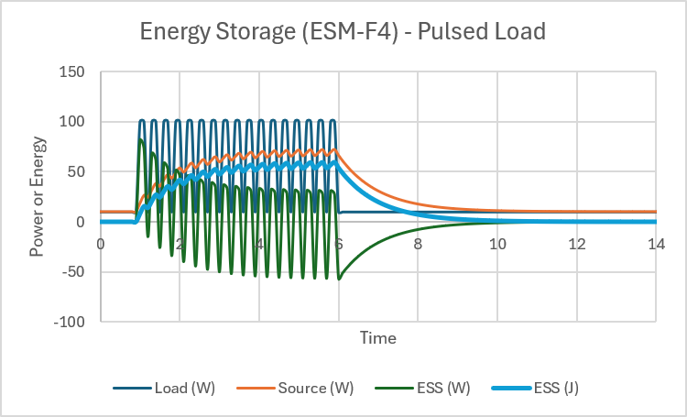
Load-leveling study (ESM-F4) – Pulsed load support
Scenario – Have pulsed load with duty cycle less than time constant of source
  Energy storage used to provide difference between power demand and power provided by source.
  Over long run, energy storage SOC regulated to midway between its minimum and maximum value. (min + half of useable energy)
Employ transient analysis to determine required power and energy capacity of the energy storage system
  Model the controls and system dynamics of both the source and energy storage.
  Energy storage should have sufficient energy capacity so that neither its maximum or minimum SOC is exceeded.
First approximation for energy storage system power and energy
  Power rating of energy storage should be at least the magnitude of the pulse.
  The useable energy rating of energy storage should be a multiplier times twice the product of the average value of the pulsed load and the source time constant.
    Multiplier provides a butter for unmodeled situations

Slide 16
Zonal and compartment survivability analysis (ESM-F5)
Zonal survivability analysis
  Each zone and pair of adjacent zones is assumed damaged
  Undamaged zones examined to ensure sufficient
    Generation capacity
    Connectivity
    Energy storage capacity
Compartment Survivability analysis
  Determines if power connectivity can be restored to undamaged mission critical equipment in damaged zones
  Determines if undamaged zones have sufficient generation and energy storage capacity to supply mission critical equipment in damaged zones

Slide 17
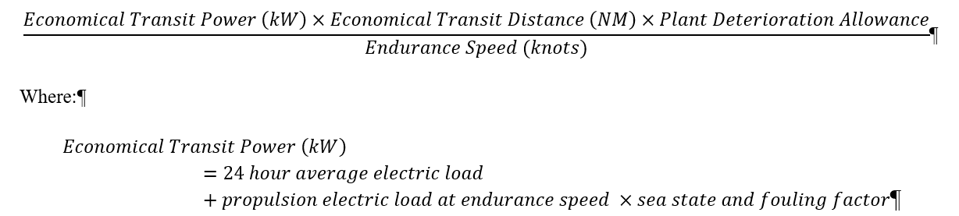
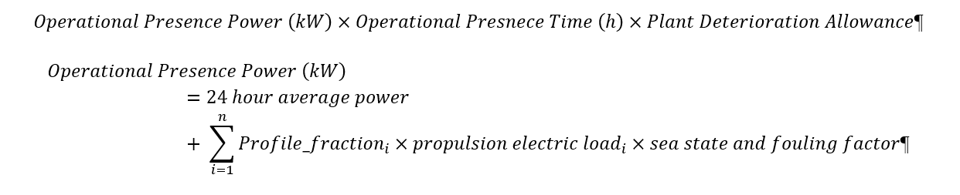
Endurance energy calculations (ESM-F5)
Required Inputs
  Economical Transit
    Economical transit distance (NM)
    Endurance Speed (kt)
  Operational Presence
    Operational Mission
    Speed-time profile (kt vs % time)
    Operational Presence time (h)
  Design Details
    24-hour average electrical load
    Propulsion electric load vs speed
    Plant deterioration allowance (1.25)
    Sea state and fouling factor (1.10)

